Slide 1
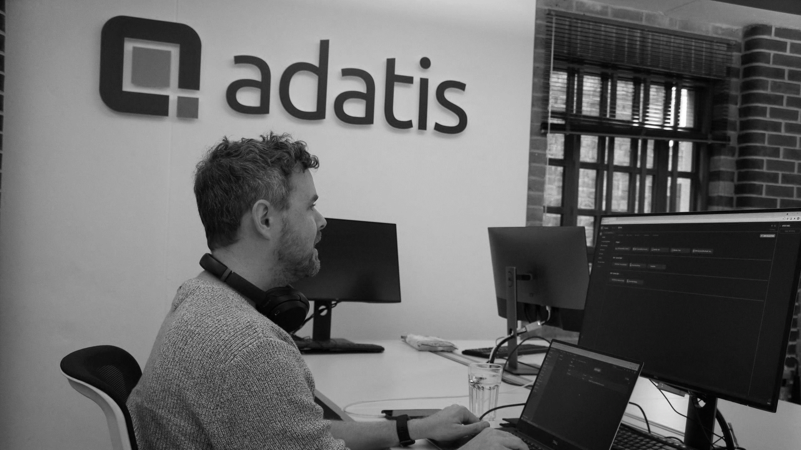




SQL Server
From the Basics
Phil Austin

Slide 2
Notes
RDBMS Theory
Relational model
Tables
Rows/Columns
Normalisation
Normal forms
ACID properties
Concurrency/contention
Locking semantics
SQL Concepts
Declarative
Set based
SQL Architecture
ProtocolsSQLOS
Storage engine
Query optimiser

Slide 3
Notes
SQL Architecture – 4 components
Protocols
SQLOS
Storage engine
Relational Engine

Slide 4


SQLOS
Memory Mgt
Synchronisation
Storage Engine
DBCC
BCP
Backup/ Restore
Relational Engine
Protocols
Command Parser
Scheduler
Log Manager
CPU
Query Optimiser
Buffer Pool
Transaction Manager
Storage
Clients
Data Cache
Access Methods
Query Executor

Slide 5
Thank you!
AdventureWorks2019 : https://github.com/Microsoft/sql-server-samples/releases/tag/adventureworks
Stack Overflow: https://www.brentozar.com/archive/2015/10/how-to-download-the-stack-overflow-database-via-bittorrent
https://github.com/phil-a10/Talks
Questions?
phil.austin@adatis.co.uk
www.linkedin.com/in/phil-austin-44147415

Slide 7
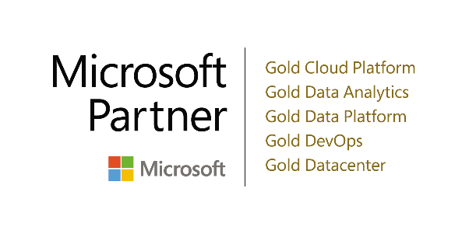
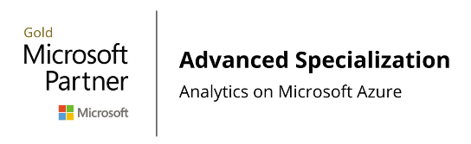









Introduction to Adatis
Microsoft Exclusive | Data & AI Specialists
Azure Purview
Launch Partner
Azure Synapse
Launch Partner
Scotland:
Aberdeen
Glasgow
England:
Manchester
London
Surrey
India:
Pune
Bulgaria:
Sofia

Slide 8


SQL Query Architecture
SQL Query
Query Optimizer
Query Plan
Database schema, Statistics

Slide 9
Introduction
For data engineers\data scientists new to SQL Server
Query scenarios techniques and options
Mostly demos
Using SQL Server Management Studio (SSMS) – free SQL client from MS
Using AdventureWorks2019 Stack Overflow databases
Interactive session

Slide 10
Thank you!

